Slide 1



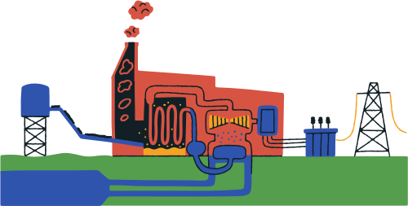
ELECTRICAL GRID

Slide 2


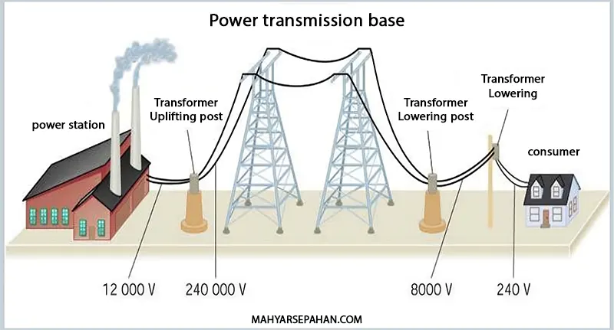
WHAT IS THE ELECTRICAL GRID?
The electrical grid is the system that delivers electricity from power stations to the users.
It mainly consists of:
• Generation (like power plants),
• Transmission (high voltage lines),
• Distribution (the final stage that reaches homes and businesses).

Slide 3


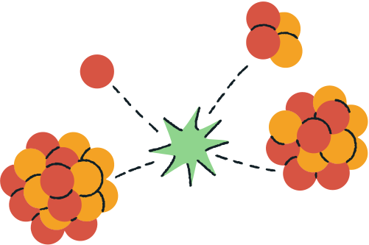

WHAT ARE WE SIMULATING?
In this project, we simplify a small part of what happens inside an actual electrical grid.
Instead of modeling the whole system, we use a 2D matrix to simulate how voltage is distributed.
It’s like watching how electricity spreads through a smaller, controlled network making it easier to understand.
The goal is to simulate how voltage is distributed across this matrix — kind of like watching how electricity spreads through a network.
This makes it easier to understand how voltage behaves in different parts of the grid

Slide 4

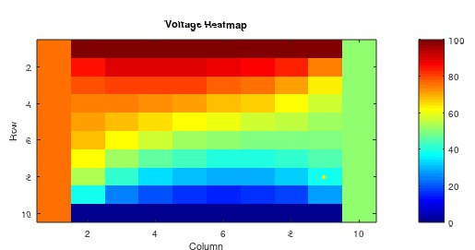
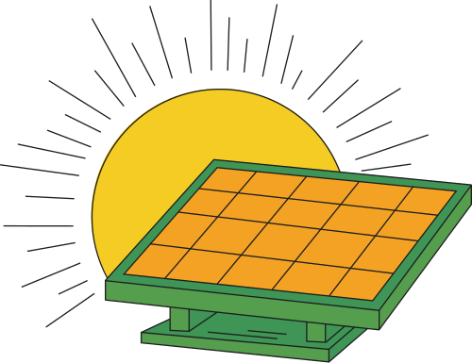
WHY VOLTAGE DISTRIBUTION MATTERS?
Voltage isn’t the same everywhere in the grid — it changes depending on where you are and what’s happening around.
This part of the project focuses on how voltage spreads across the 2D matrix.
By looking at the distribution, we can spot where voltage is high or low, and understand how it moves from one point to another.
It’s a basic step, but super useful for seeing how electricity flows.

Slide 5
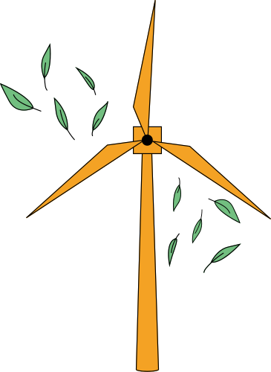
HOW THE SIMULATION WORKS
To simulate how voltage spreads, we used a simple mathematical model — specifically Laplace’s Equation.
We treated the 2D matrix like a mini-grid, and set fixed voltages at certain points (these are the boundary conditions).
Then, we let the rest of the matrix “settle” based on the surrounding values — this gives us a smooth voltage distribution.
It’s kind of like dropping heat into a surface and watching how it spreads out evenly

Slide 6

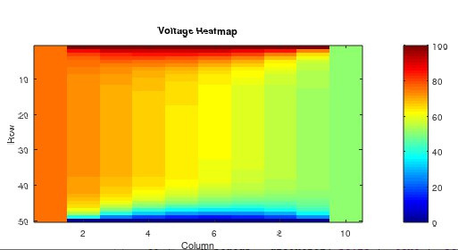
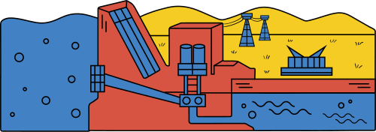
RESULTS
The results show how voltage spreads across the grid depending on the boundary conditions.
We can clearly see where voltage is high, low, or balanced

Slide 7


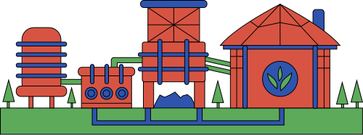
OBSERVATIONS
Voltage smoothly spreads
High voltage near sources, low far away
Boundaries strongly affect behavior
The center often stabilizes at medium voltage

Slide 8
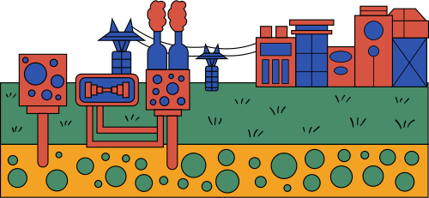

CONCLUSION
We showed how 2D matrices and the Laplace equation in MATLAB simplify voltage distribution simulations in electrical grids, improving accuracy and efficiency. Future work can focus on handling more complex factors and optimizing simulations for larger grids.

Slide 9






BENEFITS
• Easy to visualize voltage flow
• Quick to test and tweak conditions
• Useful for spotting faults
• Scalable to bigger models

Slide 10




Name : Aisha Emad Ali Code:2127158
Name : Abdelrahman Medhat
Code: 2227040
Name: Nourhan Dardeer Abdo Code: 2127030
Name: Bassant Samy
Code: 2127410
Name: Fatma Ahmed Mohamed Code: 2227459

Slide 11



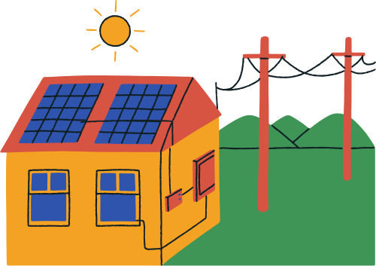



THANK YOU

